Slide 1
Virtual Machines and Web Sites

Slide 2
Agenda
Windows Azure Virtual Machines
Portability
Supported operating systems
Windows Azure Virtual Network
Windows Azure Web Sites
Gallery
Environments
Scalability
Lab: a)Building a Virtual Machine
b)Building a Web Site

Slide 3
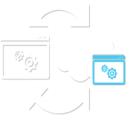




Key Scenarios – VMs and Cloud Services
Windows Azure Virtual Machine
Windows Azure Cloud Services
Migrating existing apps
Develop and Test
VM Backup to the cloud for Disaster Recovery
Hybrid
New cloud designed applications
Hybrid
Extended
Enterprise
Cloud Bursting
High
Availability
Connect new cloud apps to on-premises assets
KEY SCENARIOS

Slide 4
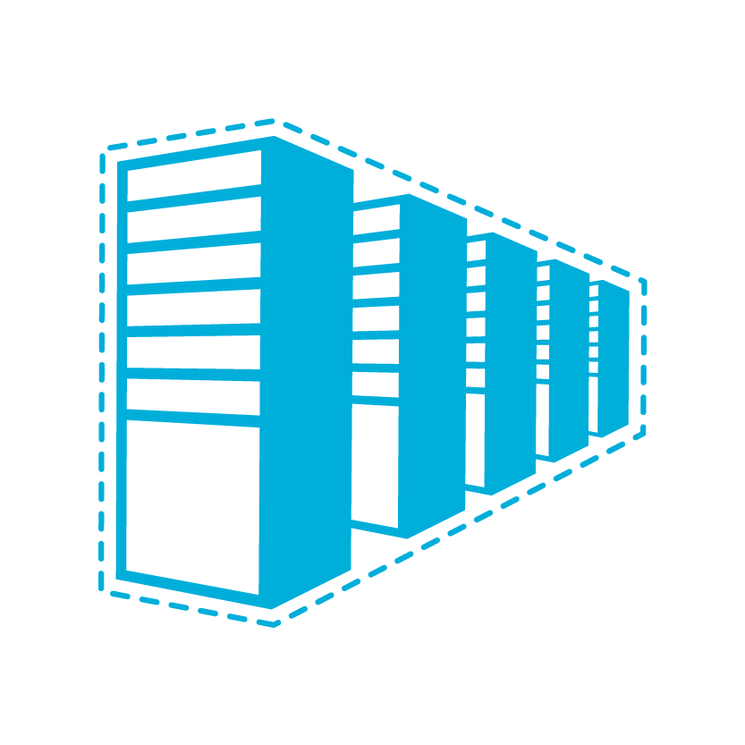

Why Use Virtual Machines for Existing Applications?
Management
Retain full control to configure & maintain the OS. Manage public & private cloud VMs centrally with Microsoft System Center.
Application Mobility
Move your virtual hard drives (VHDs) back and forth between on-premises and the cloud. No need to rebuild your app to run in the cloud.
Run popular Microsoft server applications
Run the same on-premises enterprise applications & infrastructure in the cloud, such as Microsoft SQL Server

Slide 5






Windows Azure Virtual Machines
Getting Started
Select Image and VM Size
New Disk Persisted in Storage
Boot VM from New Disk
Management Portal
Blob Storage
Scripting
(Windows, Linux and Mac)
REST API
Cloud
Notes:
Not restricted to just these images. You can also upload your own image and use that, described later in the lecture.

Slide 6


Supported Operating Systems
Supported:
Windows Server 2008 R2
64-bit
Library Images:
Windows Server 2008 R2
Windows Server 2012 RC
Windows Server 2008 R2 with SQL Server 2008 or 2012 (Available at GA. Only SQL Server 2012 Eval available at Preview))
Supported:
Community & commercial distributions including
Library Images:
SUSE Linux (SUSE Linux Enterprise Server SP2 & OpenSuse 12.1)
CentOS (CentOS 6.2)
Ubuntu (Ubuntu 12.04)
Linux

Slide 7




How it Works Select from Image Gallery
Log in to
Windows Azure
Management Portal
Create new VM from
image gallery
The image is copied to
your blob storage account
Virtual Machine booted. Changes copied to blob storage

Slide 8


How it Works Bring your own VHD
Create your own VHD
Upload image to blob storage
Create a disk using the uploaded image in the Windows Azure Management Portal
Virtual Machine booted. Changes copied to blob storage

Slide 9


How it Works No Lock-In
Windows Azure
Uses standard VHD format, easy to move between Windows Azure and On-Premises Data Centers
Equally easy to directly move to another service provider that supports VHDs
Microsoft Data Center
Other Data Center

Slide 10
Create a new Windows Server 2012 machine
demo
Notes:
Demo on Windows Azure portal

Slide 11
Networks

Slide 12



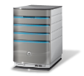



Cross-premise Connectivity
CLOUD
ENTERPRISE
Data Synchronization
SQL Azure Data Sync
Application-layer
Connectivity & Messaging
Service Bus
Secure Machine-to-Machine Network Connectivity Windows Azure Connect
Secure Site-to-Site
Network Connectivity
Windows Azure Virtual Network
IP-level connectivity

Slide 13
Does Your App Need a Virtual Network?
Persistent IP Address Requirements
Virtual Machines deployed into a virtual network have an infinite DHCP lease
Hybrid On-Premises Cloud Apps
Requirement for connectivity between your data center and the public cloud
Connectivity between cloud services.
Deploying Active Directory in the Cloud or connecting a PaaS to IaaS Service
Enterprise Identity and Access Control
Manage identity and access control with on-premise resources (on-premises Active Directory)
Monitoring and Management
Remote monitoring and trouble-shooting of resources running in Windows Azure

Slide 14
Windows Azure Networking
Virtual Network
For network administrators
Provides network admins the control to setup subnets in the Cloud and manage them as extensions of on-premise datacenters
Subnets in Windows Azure
On-premise subnets

Slide 15
Windows Azure Virtual Network
“Virtual” datacenter in the cloud
Enables extension of Enterprise Networks into Windows Azure
Networking on-ramp for migrating existing apps and services to Windows Azure
Enables “hybrid” apps that span cloud and on-premises
Protected private virtual network in the cloud
Enables customers to setup secure private IPv4 networks fully contained within Windows Azure
Inter-service DIP-to-DIP communication
Corpnet
Windows Azure
VM 1
VM 2
Subnet 1
Subnet 2
ROLE 1

Slide 16
Identity Management
Active Directory and Windows Azure

Slide 17
AD in the Cloud
Support pre-requisites for other apps or services
Direct Authentication for Applications in the cloud
Federation with ADFS
Serve as a substitute or failover for existing domain
Serve as primary authority for cloud only data center

Slide 18
Deploying AD in a Windows Azure VM
Cloud Service with Initial Domain Controller
Virtual Network Name
Existing DNS Servers (If any)
Virtual Network Subnet
Domain Join Settings (If existing domain)
Separate Data Disk for Active Directory Database
DCPromo
Create Separate Cloud Service for AD Members
Specify DNS at Deployment Level Using PowerShell for VMs

Slide 19
Cloud Services Configuration for AD
The Domain Controller can be located wherever convenient:
Domain Controller in Separate Cloud Service
Domain Controller On-Premises
Domain Controller in the Cloud
On-premises and Cloud can have separate Domain Controllers

Slide 20
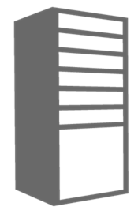
Domain Controller in Separate Cloud Service
Cloud Service for AD Domains
Location: North Central US
Name: ad-cloudservice.cloudapp.net
Affinity Group: ADAG
Cloud Service for AD Clients
Location: North Central US
Name: app-cloudservice.cloudapp.net
Affinity Group: ADAG
Deployment
Virtual Network: ADVNET
DNS Ips: (On-Premise AD IP)
Deployment
Virtual Network: MyVNET
DNS Ips: 192.168.1.4
Virtual Machine
Role Name: ad-dc
Subnet: ADSubnet
IP Address: 192.168.1.4
DIP
Virtual Machine
Role Name: advm1
Subnet: AppSubnet
IP Address: 192.168.2.4

Slide 21
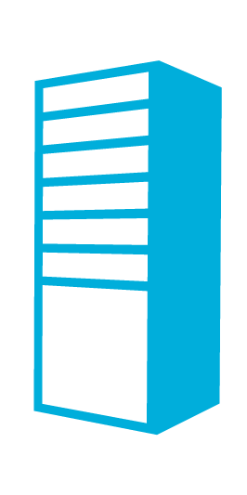

Domain Controller On-Premises
Contoso.com Active Directory
Contoso.com Active Directory
Contoso Corp Network
The Virtual Network
in Windows Azure
SQL Servers
IIS Servers
Site to Site VPN Tunnel
AD Authentication
+
On-Premises Resources
Gateway
AD / DNS
S2S VPN Device
IIS Servers
SQL Servers
Exchange
Load Balancer
Public IP

Slide 22

Domain Controller in the Cloud
Contoso.com Active Directory
Contoso.com Active Directory
Contoso Corp Network
The Virtual Network
in Windows Azure
SQL Servers
IIS Servers
Site to Site VPN Tunnel
AD / DNS
AD Replication
+ On Premises Resources
Gateway
AD / DNS
S2S VPN Device
AD Auth
IIS Servers
SQL Servers
Exchange
Load Balancer
Public IP

Slide 23

Active Directory Cloud Only
Contoso.com Active Directory
Contoso Corp Network
Extranet Active Directory
The Virtual Network
in Windows Azure
SQL Servers
IIS Servers
Site to Site VPN Tunnel
AD / DNS
On Premises Resources
Gateway
AD / DNS
S2S VPN Device
AD Auth
IIS Servers
SQL Servers
Exchange
Load Balancer
Public IP

Slide 24
Web Sites

Slide 25
Windows Azure Web Sites
More like SaaS than PaaS
No need to handle Firewall Rules
Gallery provides many popular applications, such as:
DotNetNuke
Drupal
Joomla
WordPress
Build with ASP.NET, Node.js or PHP
Use Windows, Mac or Linux machines for development
Deploy using FTP, Git or TFS

Slide 26
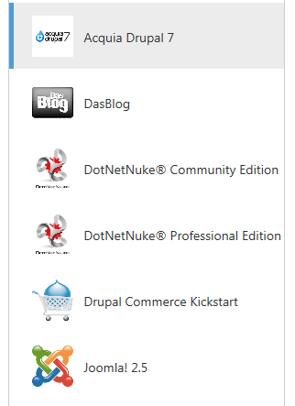
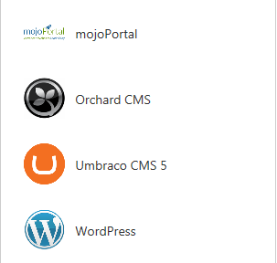
Web Sites Gallery

Slide 27
Create a new Web Site from the Gallery
demo

Slide 28
Development Environments
Choice of Web Frameworks
ASP .NET
Classic ASP
PHP
Node.js
Databases
SQL Database
MySQL

Slide 29



Development Environments
Development OS
Windows
Linux
Mac
Publishing Methods
FTP
Git
Web Deploy
TFS Deploy
Source Control
Git
TFS
GIT : FTP
1010111001010101010001010100011
GIT : FTP
1010111001010101010001010100011
GIT : FTP
Web Deploy : TFS Deploy
1010111001010101010001010100011

Slide 30
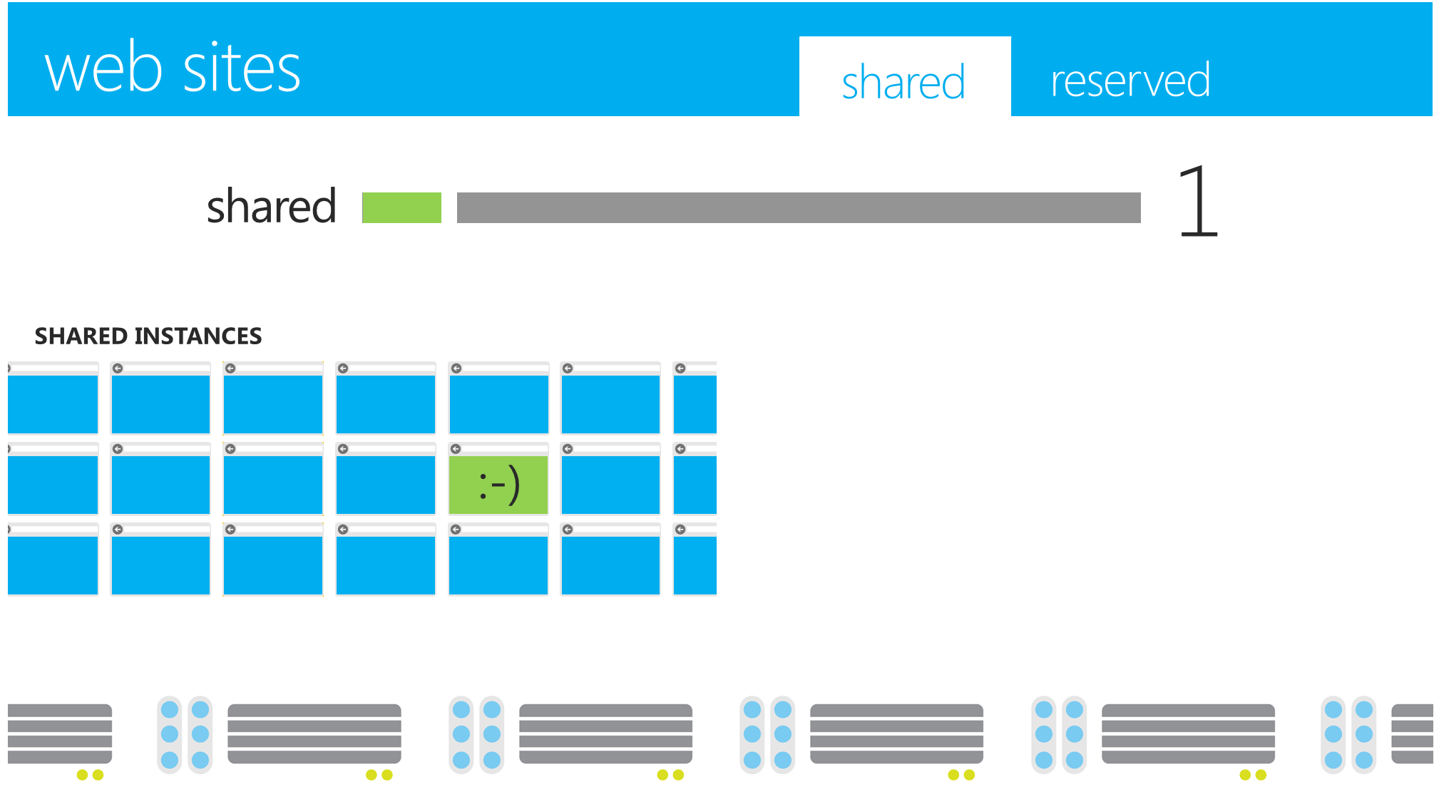
Scalability
Start with free shared instance

Slide 31
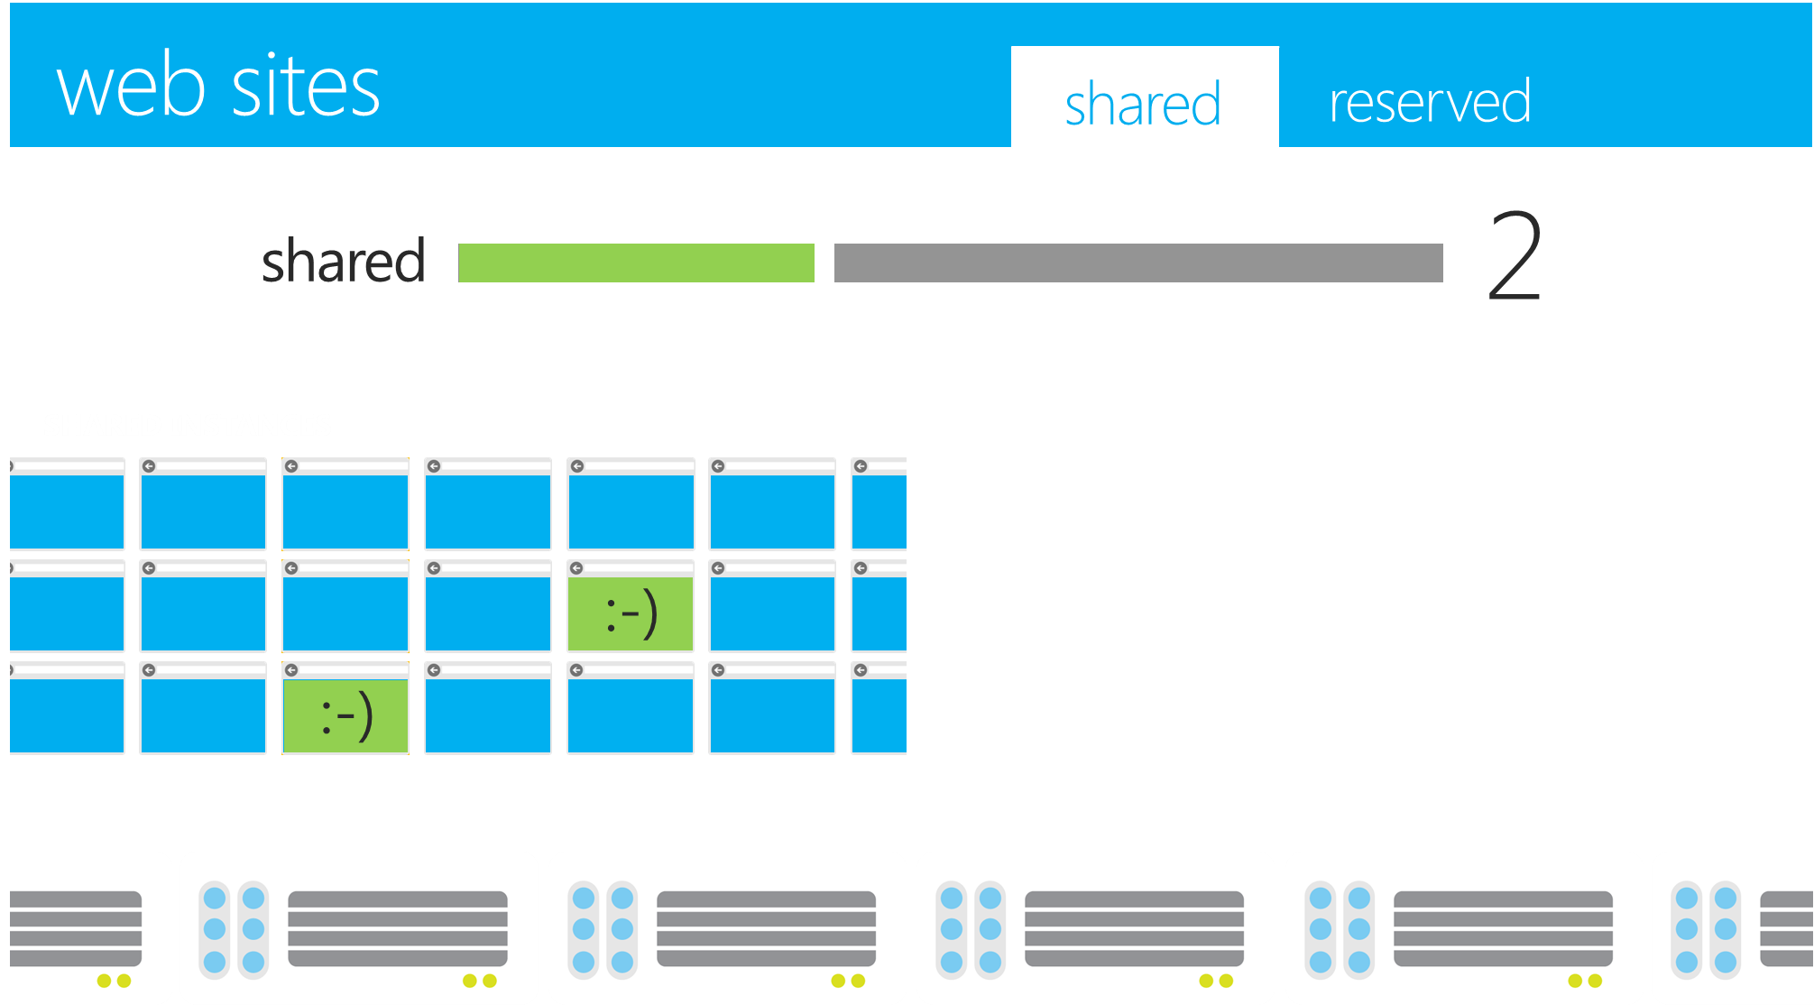
Scalability - Out
Start with free shared instance, Scale Out as traffic grows

Slide 32
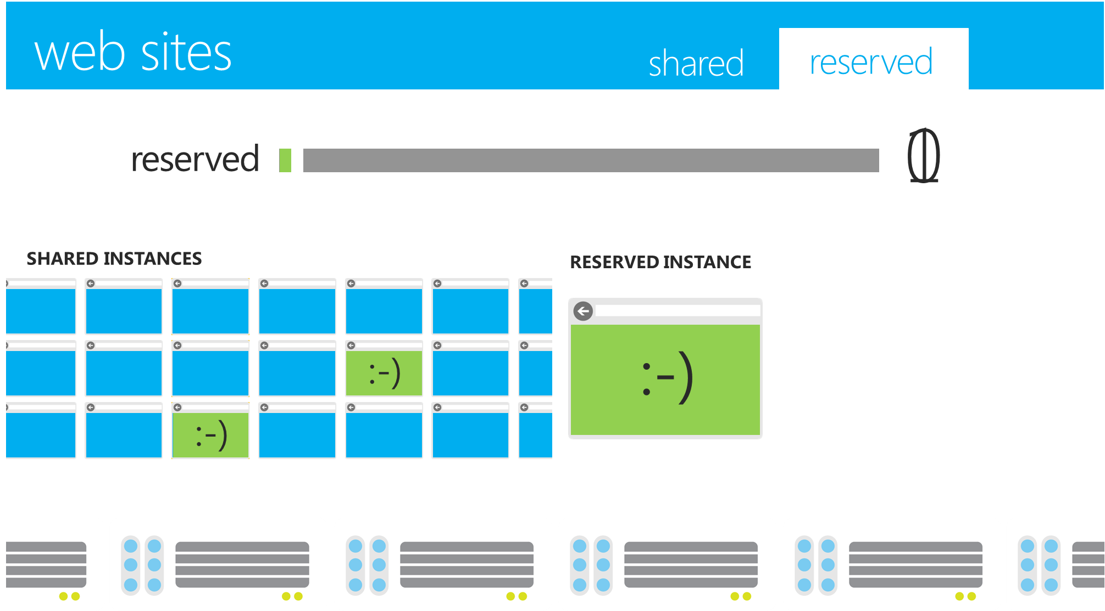
Scalability – Switch Up
Start with free shared instance, Scale Out as traffic grows, Scale Up to reserved instance when required

Slide 33
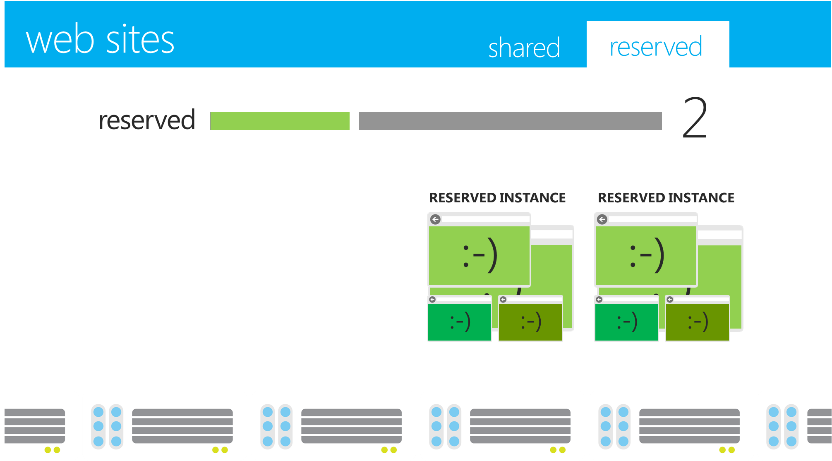
Scalability – Out again
Start with free shared instance, Scale Out as traffic grows, Scale Up to reserved instance when required
Scale Out even further!

Slide 34
Advantages of Cloud
Different Cloud accounts have identical environments
There are invariably minor differences between different machines in on-premises environments
Many Cloud platforms support quick roll back of changes in production
By providing a Swap operation between two deployments
No risk of development and testing staff accidentally testing on live data
Access to the production storage and databases can be controlled and isolated from the test storage and databases

Slide 35
and the Disadvantages…
Any time you do something, even if it is only testing, it costs money
Billed for all environments used – Production, Staging and testing
Connectivity issues can hinder testing and diagnosis

Slide 36
Deployment Best Practices
Use scripts because it means that operations can be repeated reliably
Log, so that errors are captured, which may assist in debugging problems
Automate as much of the process as possible

Slide 37
Testing
Test locally first – does not cost
For Windows Azure, most testing can be performed on the development machine by using the Compute Emulator and Storage Emulator
Deploy an application to the Cloud test environment only when it is running successfully locally and ready for final testing to minimize the charges
Windows Azure charges separately for production and staging, so make sure that staging is deleted when not required
Be aware of the charging unit
Windows Azure Compute is charged by the hour, so a 10 minute test will cost the same as a 59 minute test
Windows Azure SQL Database is charged by the maximum size per day, so a 5 GB test database used for 1 hour will cost more than a 1 GB test database used for 1 day

Slide 38
Quiz
Q: Windows Azure Virtual Machines are available out of the box with which of the following operating systems:
Ubuntu Linux
VMS
CentOS
MVS
Ans: Ubuntu and CentOS. VMS is a legacy OS that was available for DEC machines, and MVS is for IBM Mainframes

Slide 39
Quiz
Q: Windows Azure Web Sites Gallery contains which of the following open source offerings:
Joomla
OSCommerce
Magento
WordPress
Ans: Joomla and WordPress

Slide 40
Thanks !~

